Slide 1
Nebraska TIS
Service – Toll-free phone consultation to patients or health care providers about exposures during pregnancy
Education – to public and academic groups, including medical, nursing, genetic counseling, pharmacy and others
Research – collaborative projects looking at outcomes of exposures to specific agents

Slide 2
Background Risk
The general population risk for a baby to have a congenital anomaly is 3%
Our goal is to limit the impact of medications and other exposures on that baseline risk

Slide 3
Causes of Malformations
Genetic 28%
Toxicants 3%
Uterine factors and twinning 3%
Multifactorial 23%
Unknown 43%

Slide 4
Teratogen Definition
Traditionally, a teratogen was considered to be any environmental agent such as a drug, chemical, infection, or pollutant which potentially harms the developing fetus.
Dr. Tony Scialli (REPROTOX) prefers the term “reproductive toxicant” since it is not only the agent itself, but dose and timing which result in the hazard.

Slide 5
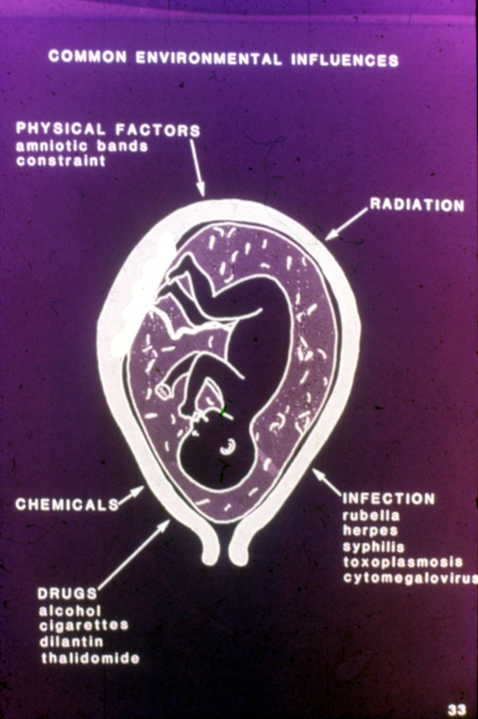

Slide 6
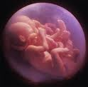
History
Lamarckism
pregnant woman sees a rabbit; baby is born with ‘hare’ lip
Impervious womb
Woman and her uterus screen out all toxicants
Thalidomide
the era of 100% risk

Slide 7
Wilson’s Principles of Teratology
Four basic manifestations of abnormal development:
Pregnancy loss, malformations, growth retardation, functional deficits
Susceptibility is dependent on genotype
Nature of damage depends on timing of exposure
Rate and severity are dose dependent
Syndrome of outcomes is specific to the insult
Plausible biologic explanation for the mechanism of action of the teratogen

Slide 8
Principle I Types of reproductive toxicity
Alterations in libido, fertility, menstruation
Gene mutations or chromosome breaks in egg/sperm
Pregnancy loss (SAB, neonatal death)
Fetal malformations
Fetal growth retardation
Behavioral teratogenesis (cognition, behavior)
Transplacental carcinogenesis

Slide 9
Paternal Exposures
Sperm develop over 70 day time period
Possible effects:
DNA mutations or chromosome breaks
(chemo, radiation)
Alterations to fertility
Excreted in semen, absorbed by woman, directly affects fetus
??? Affects methylation
Poorly studied, but little evidence male exposures cause birth defects

Slide 10
Principle II Susceptibility dependent on genotype
Exposure Genetic Basis Outcome
Phenytoin Deficient epoxide hydrolase Embryopathy
Alcohol Alleles of ADH and ALDH FAS
Smoking TGF alpha alleles Oral clefts
Retinoic acid Distribution of cell receptor Embryopathy

Slide 11
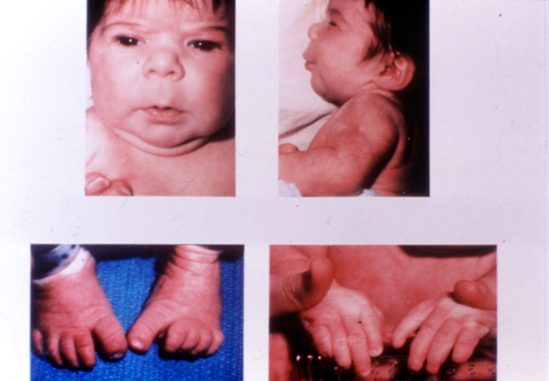

Slide 12
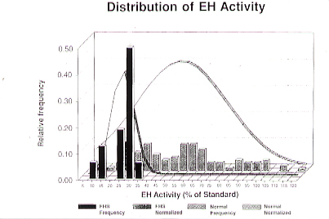
Dilantin Teratogenicity: partially dependent on fetal epoxide hydrolase activity

Slide 13
Genetic susceptibility Smoking and oral clefts
 | Non-smokers | >10 cigarettes/day
Normal TGF-alpha | OR 1.0 | OR 1.8
TAQ LC2 variant allele | OR 1.1 | OR 10.2

Slide 14
Pharmacogenomics

Slide 15
Principle III Nature of damage depends on timing of exposure
Period when a structure is sensitive to insult….leads to permanent damage
Generally just prior to or during appearance of the structure in the embryo
Functional maturation take longer than structural development

Slide 16
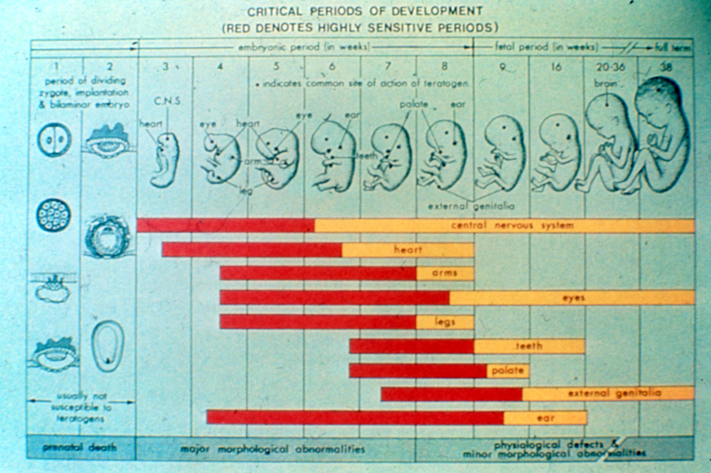
Timing of Exposure

Slide 17
Gestational Age and Teratogenic Exposure
Post-fertilization days 0 to 15: miscarriage, fetal death
Post-fertilization days 15 to 60: fetal death, major malformations, growth retardation, impaired IQ
Post-fertilization days 60 to 80: fetal death, vascular disruption caused by hypoxia, hemorrhage, and tissue loss
Second or third trimester: stillbirth, growth retardation, impaired IQ

Slide 18
Principle IV Rate and Severity are Dose-dependant
A dose-response relationship is observed. The greater the exposure during pregnancy, the more severe the phenotypic effect.
The nature of the manifestation may vary depending on the threshold for malformations, embryolethality, and functional deficits

Slide 19
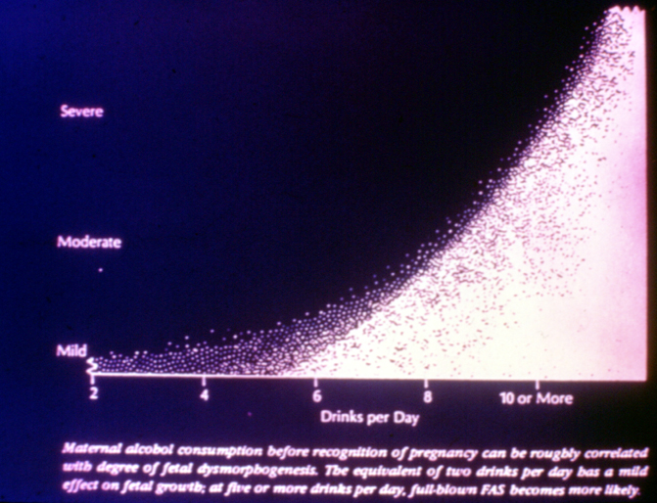
Dose and Duration of Exposure

Slide 20
Principle V Syndrome of outcomes is specific to the toxicant
Likely due to access of chemical to susceptible tissues, metabolic pathways, receptors in particular structures…..
Examples:
Thalidomide…phocomelia
Alcohol…characteristic facies, growth retardation, functional deficits

Slide 21
Alcohol
Pregnancy loss
Fetal Alcohol Syndrome:
Growth retardation
Central nervous system dysfunction (mental retardation, hyperactivity)
Characteristic facial features
Malformations
Binge drinking (4 or more drinks on occasion may be at least as risky as daily use of moderate amounts
Concentration in breastmilk is equal to maternal blood concentrations; more than one drink a day may cause infant drowsiness & delays
Conover EA, Jones KL. 2012. Safety concerns regarding binge drinking in pregnancy. Birth Defects Research (Part A) 94:570-575.

Slide 22
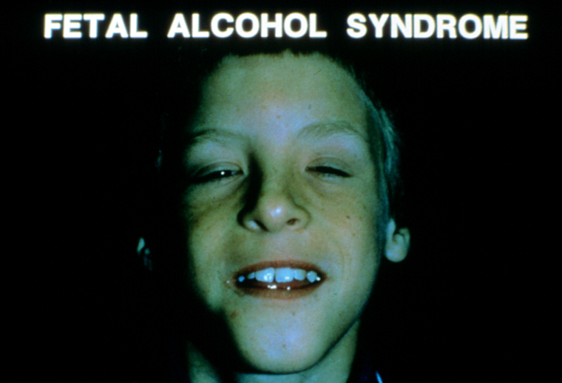

Slide 23
Principle VI Specific mechanisms of action lead to the abnormal development
Mutations of genes critical for development
Chromosomal damage (radiation)
Receptor-ligand interactions (hormones)
Enzyme inhibition
Interference with cell-cell interactions

Slide 24
Hot Topics

Slide 26
iPledge
2 forms of effective contraception during the 1 month before through 1 month after isotretinoin therapy
2 negative urine or blood pregnancy tests prior to therapy, and pregnancy test repeated each month patient is on isotretinoin
iPledge system verifies all criteria have been met, and gives pharmacist permission to dispense medication
122 pregnancies in 1st year of use

Slide 27
COVID-19
https://mothertobaby.org/pregnancy-breastfeeding-exposures/covid-19/
Health care providers can refer pregnant and breastfeeding patients with known or suspected COVID-19 infection at the following link https://mothertobaby.org/healthcare-professional-referral-form/ or by calling MotherToBaby Pregnancy Studies at (877) 311-8972.

Slide 28
Immunizations
General Recommendations :
Women can receive appropriate vaccines during pregnancy and breastfeeding
Inactivated, recombinant, subunit, polysaccharide, and conjugate vaccines, as well as toxoids, pose no risk for mothers who are breastfeeding or for their infants."
Caution is used with live organisms
Varicella
MMR
http://www.cdc.gov/vaccines/pubs/preg-guide.htm

Slide 29
Vaccination strategies to protect infants
Notes:
90% of pertussis deaths occur in infants too young to be vaccinated, this is why it is so important to focus our prevention efforts on protecting infants.

Slide 30
Tdap in Pregnant Women
ACIP recommends a Tdap immunization in all pregnant women. Health-care personnel should administer a dose of Tdap during each pregnancy irrespective of the patient’s prior history of receiving Tdap.
To maximize the maternal antibody response and passive antibody transfer to the infant, optimal timing for Tdap administration is between 27 and 36 weeks gestation.
For women not previously vaccinated with Tdap, if Tdap is not administered during pregnancy, Tdap should be administered immediately postpartum.
2014 study published in JAMA (and numerous studies since then) did not detect an increase in adverse outcomes in exposed fetuses, and noted high concentrations of pertussus antibodies in newborns. No impact on infant response to DTaP were found.

Slide 31
Maternal Diabetes
Preconception planning; poorly controlled diabetics may have as high as a 25% risk for fetal malformations
If a patient is not adequately controlled by diet and exercise, insulin has traditionally been the treatment of choice
Some oral hypoglycemic agents well studied in pregnancy and may be used as adjunct to insulin.

Slide 32
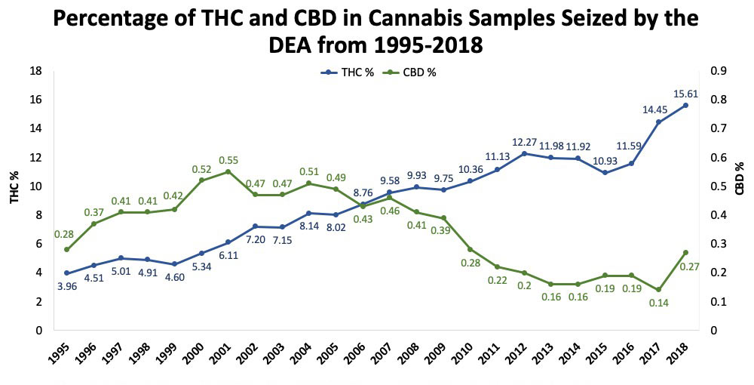
Marijuana
Marijuana contains ~400 active chemicals, and may also contain contaminants such as other drugs or pesticides
Today’s marijuana up to 30x more potent than marijuana studied in the past
Long term use can affect fertility in men and women
Some studies show an association with birth defects like gastroschisis, but most do not
Studies show pregnancy complications like prematurity, low birth weight, and withdrawal symptoms after birth
Unknown as to whether marijuana can affect brain development of the baby
https://mothertobaby.org/fact-sheets/marijuana-pregnancy/

Slide 33
Alternative Medicine
Most herbal preparations and vitamin supplements have not been studied with regard to their effect on the fetus and breast-fed infant.
In many cases there is no evidence they are teratogenic, but they are not known to be safe, either.
Generally, they are best avoided in pregnant and breastfeeding women.

Slide 34
Cosmetic Preparations
Topical (generally low systemic levels and thus minimal fetal exposure)
Poorly studied in pregnant and breastfeeding women
No proven risk, but in many cases limited benefits

Slide 35
“To dye or not to dye???”
Difficult to guarantee safety
May want to limit exposure during 1st trimester
Likely low risk in breastfeeding women
Consider highlighting
https://mothertobaby.org/fact-sheets/hair-treatments-pregnancy/

Slide 36
Beth Conover, APRN, CGC

Slide 37
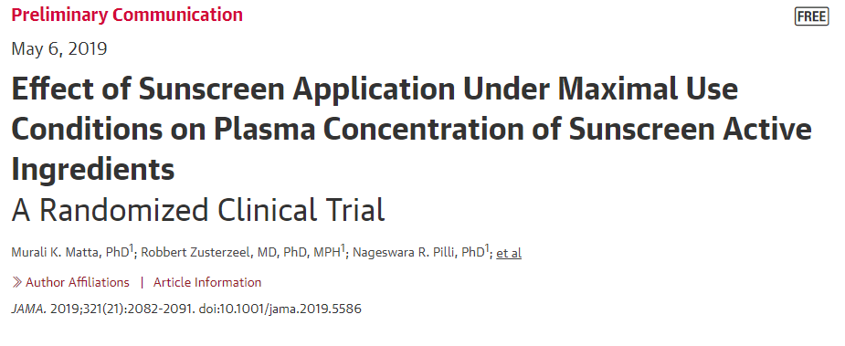

Slide 38
Conundrums
Pregnant women often tend to overestimate the magnitude of teratogenic risk.
Health providers may also have distorted perceptions of risk, even in the presence of evidence-based facts.
Teratogen (and other medical) data is often limited and contradictory.
Situations where there is no data or inadequate data predispose to inaccurate and extreme interpretation:
No data…assume huge risk or
No data…assume zero risk

Slide 39
Facilitating Decision Making
Use the terms ‘chance’ (likelihood, probability…)instead of ‘risk’ because them imply less of a value judgment of good or bad outcome
Provide numbers in different formats
Ex: use both percentage and ratio (25% or 1 in 4)

Slide 40
Risk and Benefit Considerations
Medication Risks
Baby and pregnancy:
possible small increase in risk for birth defects (especially heart)
Possible increase in risk for neurocognitive problems—ADHD, autism, psychiatric illness, delays
Preterm Delivery
Persistent Pulmonary Hypertension
Neonatal Abstinence Syndrome
Uncontrolled Depression
Maternal:
Misery
impaired relations with family
Poor prenatal care
use of alcohol/tobacco/illicit drugs
Baby and pregnancy:
Miscarriage
Preeclampsia
Preterm delivery
Low birthweight
Avoid Medication
Consider Medication
Offer Support/Counseling to all

Slide 41
Strategies to Improve Odds of a Healthy Baby: Folic Acid Supplementation
Taking a multivitamin containing at least 0.4 mg of folic acid prior to and during pregnancy lowers the risk for a variety of birth defects including:
Spina Bifida (50-70%).
Cleft lip and/or cleft palate (25-50%).
Serious heart defects (30-50%).
Limb defects (30%).
High dose folic acid (2-4mg) recommended for women on an anticonvulsant, who have diabetes or inflammatory bowel disease or who have had a previous child with spina bifida, CL/CP, or a heart defect

Slide 42
Non-Medication Strategies
The combination of bright light therapy plus an antidepressant significantly improves nonseasonal major depressive disorder, and light therapy alone is more effective than antidepressant monotherapy, a randomized, placebo-controlled trial suggests
JAMA Psychiatry. 2016;73(1):56-63.

Slide 43
Resources
Hale, T. Medications and Mothers’ Milk. Amarillo, TX: Pharmasoft;
LactMed, http://toxnet.nlm.nih.gov/cgi-bin/sis/htmlgen?LACT
Briggs, G. et al. Drugs in Pregnancy and Lactation, 11th edition. Philadelphia: Lippincott, Williams & Wilkins.
TERIS and REPROTOX data bases

Slide 44
New FDA Pregnancy and Lactation Labeling Rule
Eliminates pregnancy letter catagories (ABCDX)
Provides narrative risk summaries on use in pregnancy and lactation
Offers clinical considerations
Explains how data can be used to determine human risk
Encourages updates
All medications approved by the FDA since 2001 must revise their pregnancy and lactation section
All medications must remove ABCDX, regardless of when approved.

Slide 45
A service of the Organization of Teratology Information Specialists
www.mothertobaby.org
National Phone Number:
(866) 626-6847
option for Spanish speaking TIS counselor
NE-TIS
(402)-559-5071

